Slide 1
ASP.net Core Middleware Shubham Pakale

Slide 2
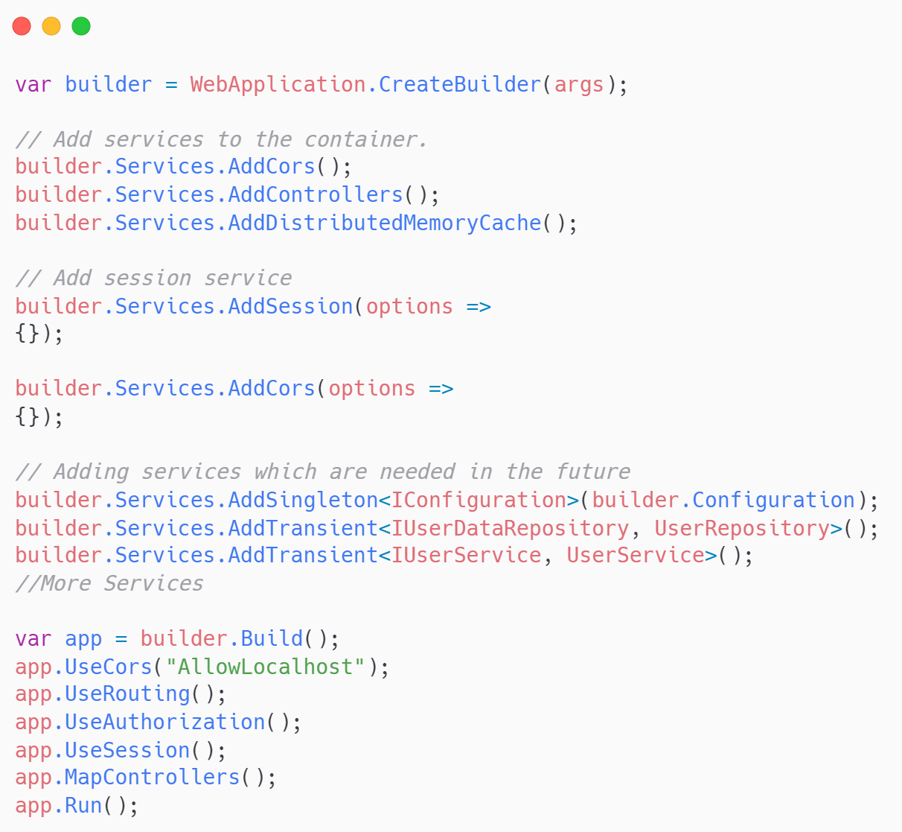
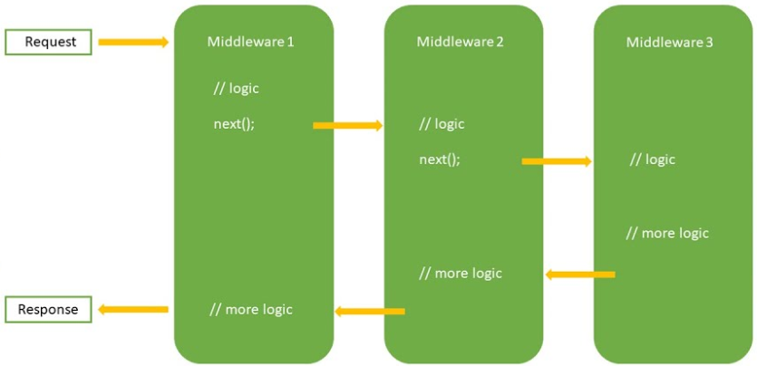
ASP.net Core Middleware in E-Commerce

Slide 3
Common Middleware Types
Exception/Error Handling Middleware:
Development Environment (UseDeveloperExceptionPage)
Production Environment (UseExceptionHandler)
Static Files Middleware(UseStaticFiles)
Routing Middleware(UseRouting)
Authentication Middleware(UseAuthentication)
Authorization Middleware:(UseAuthorization)
Session Middleware(UseSession)
Endpoint Routing Middleware(UseEndpoints)

Slide 4
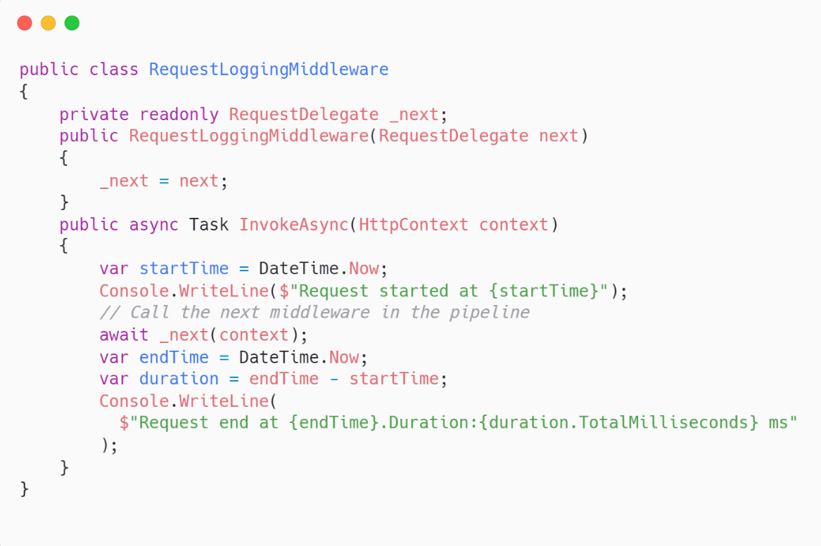
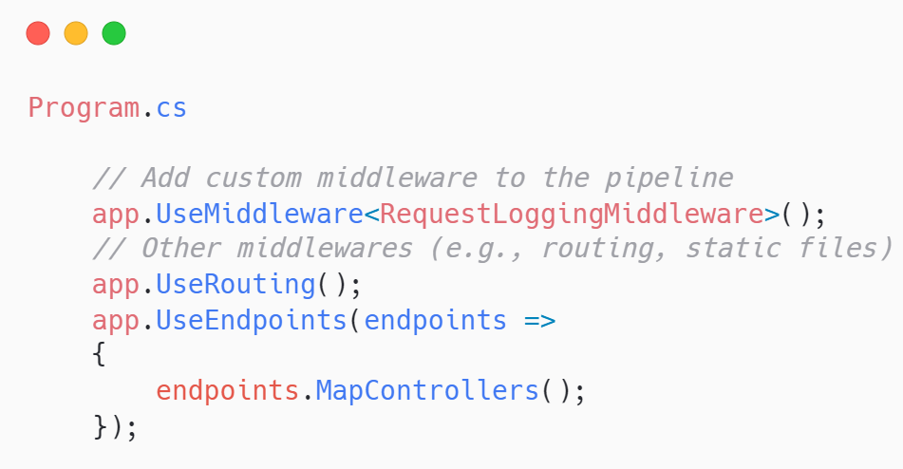
Custom Middleware
Steps to Create Custom Logging Middleware
1.Define custom middleware class 2.Register Middleware in the Pipeline (Program.cs)

Slide 5
Advantages of Middleware
Advantages
Separation of Concerns
Modular and Reusable
Customizability
Error Handling
Allows for clean separation of concerns by encapsulating different aspects of request processing into distinct components.
Reusable across different projects or parts of and application.
Custom middleware to handle application-specific scenarios such as logging, authentication.
Catch and handle exceptions in a structured way, improving app stability and user experience by providing consistent error responses.

Slide 6




THANK YOU
(844) 720-6678
info@simplifyhealthcare.com
simplifyhealthcare.com
Simplify Healthcare
U.S.: 600 N Commons Drive, Suite 110, Aurora, IL 60504
India: 401/402, 4th Floor, Pentagon P-2, Magarpatta City, Pune 411013
CONNECT WITH US
LinkedIn
YouTube
X
Instagram

